Slide 1
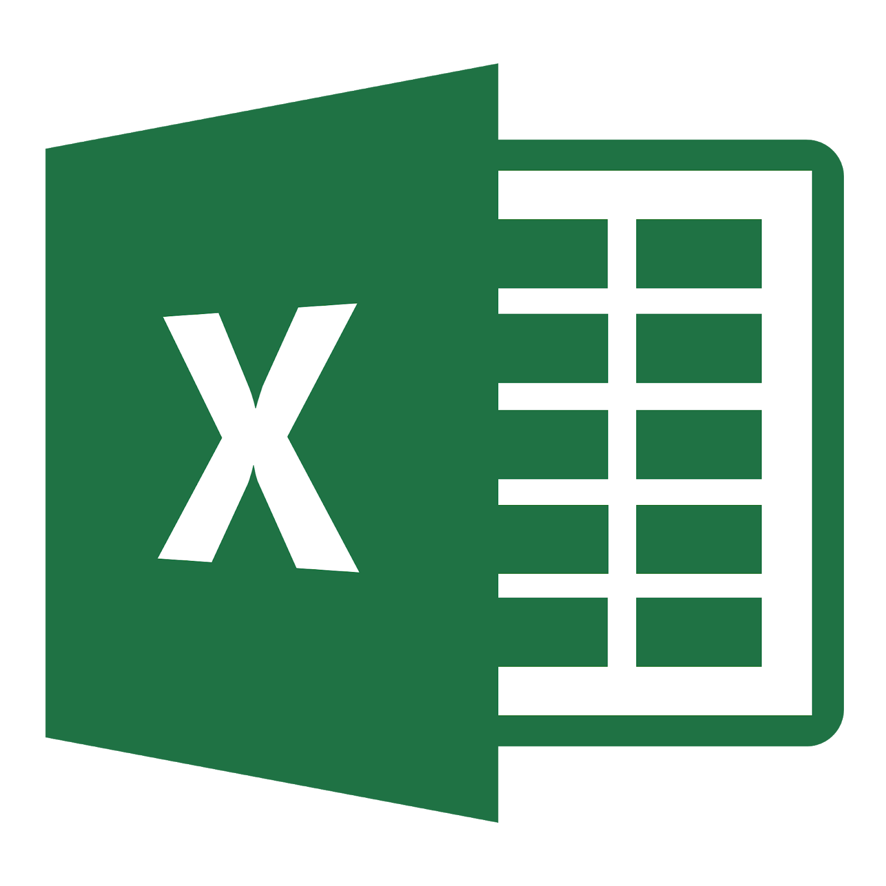

[Legacy System]
Introduction
Process Map
Commit PO
Dashboard
Amazon
Server
DB
Buyer PO
Menu
Description
The subject with Red highlight are mandatory data to insert.
Indent no. : It is not allow to update to Duplicated
Brand name : If there is new buyer come up, please request to update to “antoniolee@daehan.co.kr”
Design No. : Parent Style no.
Season name : If there is new, please add from basic Information menu
Season year : If there is new, please add from basic Information menu
Gender : select to item
Fabric Type : select to item
Garment Type : select to item
Order Type : If there is new, please add from basic Information menu
Order Option : If there is new, please add from basic Information menu
Manufacturer name : If there is new buyer come up, please request to update to “antoniolee@daehan.co.kr”
“Design Cover”
“PO Upload”
“PO Upload Tool”

Slide 2
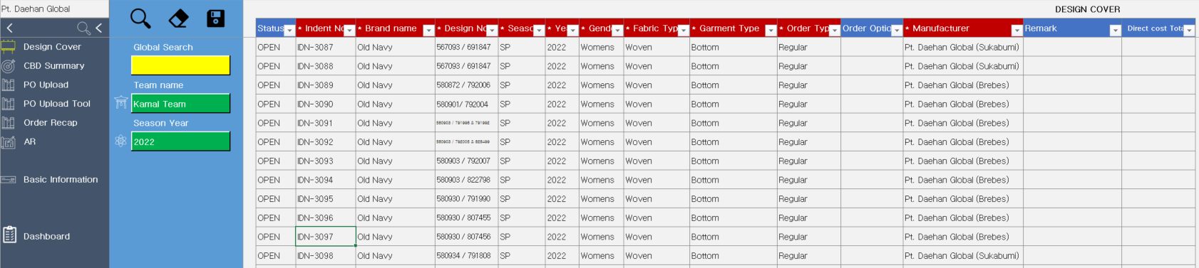
[Legacy System]
Functions
1
3
4
5
2
8
6
7
Company (Vendor) name : Select to your company name
Close the Menu or Function screen
Search data based on selected options
Delete the tables
Save datas (new / revise / delete items)
Global Search : you can find the data that you know any of word. For example, if you want to find “Old Navy” then you can type here as “Old”. Then the result should be shown data included “Old” for all.
Options : Team / Season year select to find out if you are not find out data by Global search function. Please delete input data from Global search if you want to use this function result
Red Highlight data mandatory to update.

Slide 3
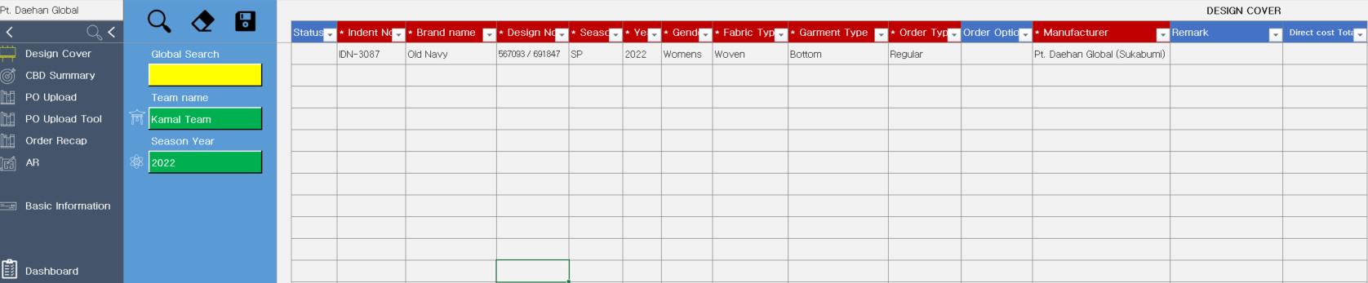
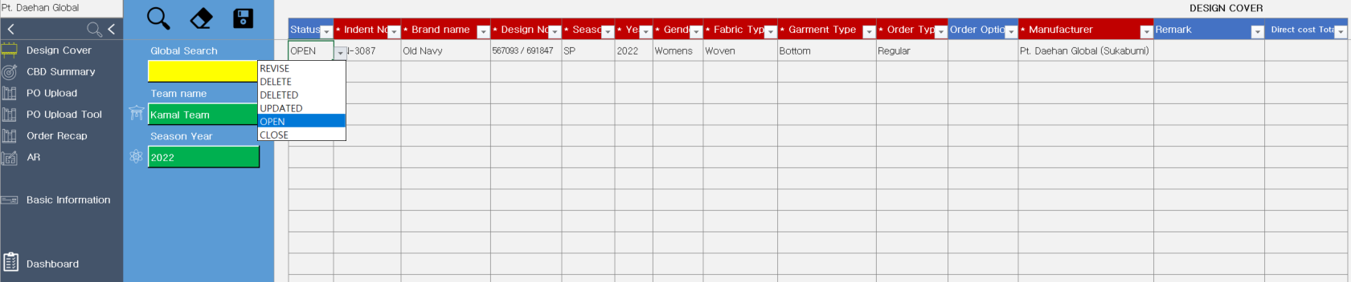
[Legacy System]
How to USE with the sample [Design Cover]
Select or type in the new Design Cover as following screen shot and click to “Save” Button.
After saved data if you want to revise or Delete then please select to Item as the screen shot below.

Slide 4
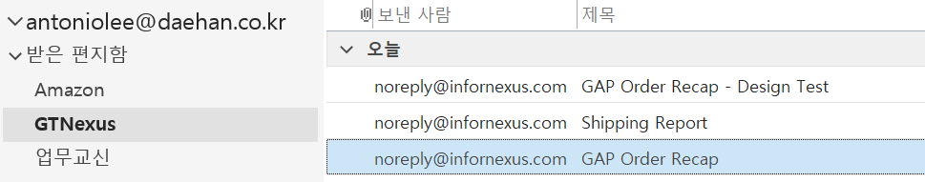

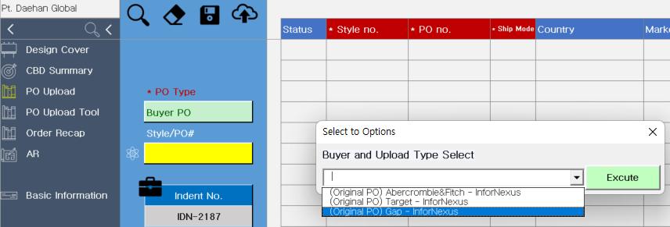
[Legacy System]
How to USE with the sample [PO Upload] : GAP and Target
Download the file from your email : “Gap Order Recap” and open the file
Click to button red circle below and the window popup will be shown. Please select to “(Original PO) Gap - InforNexus” and then click to “Excute” button

Slide 5
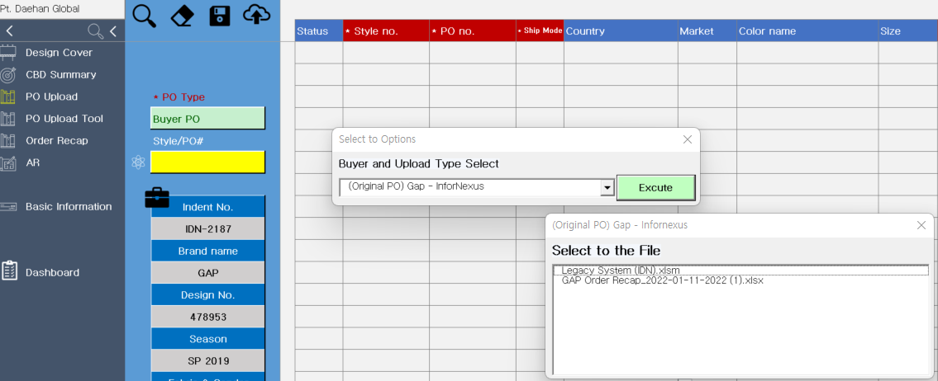
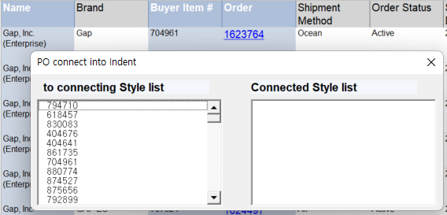
2nd window pop up will be show as the following screen shot. Please select to “Gap Order Recap” file that you just download and opened. Double click the file name.
3rd window pop up will be show as the following screen shot.
The following is for match up the style (child Style no.) with Design Cover name (parent Style no.)

Slide 6
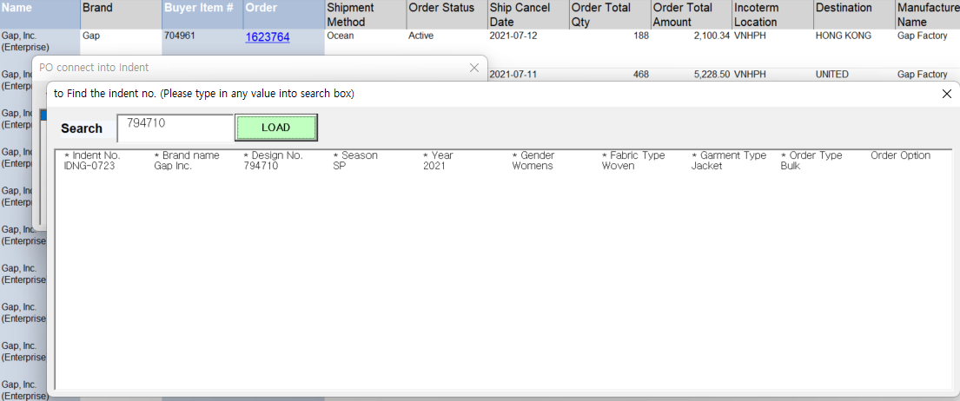
Double click the style no. then the another pop-up scress will be shown. Please search (LOAD) and select to correct Design cover file.
If you select the correct Design cover file name and double click then the data automatically update into the Server.
Otherwise after you must the create the design cover file do it again.
For Target the same process but according to buyer and Infornexus contacted rule, the unit price doesn’t show.
After update the files from InforNexus file the user must correction to update the unit price as well.

Slide 7
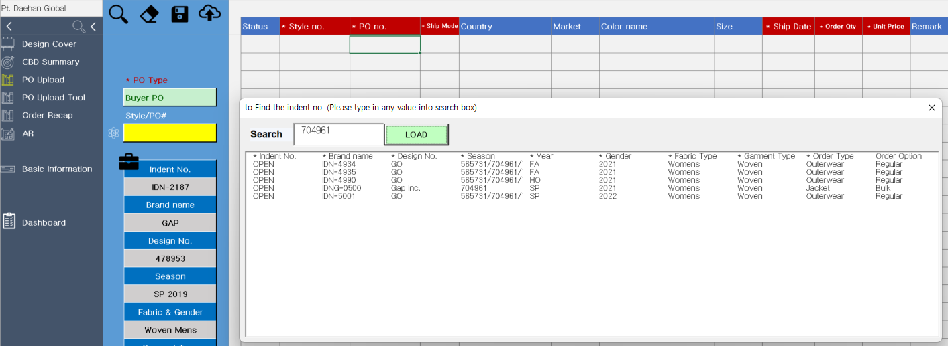
[Legacy System]
How to Revise/Delete the PO file
Please click to button below and select the design cover file name. and then the search button to shown the data successfully.

Slide 8
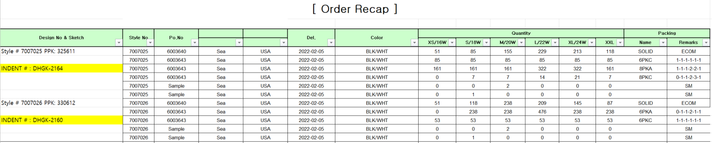
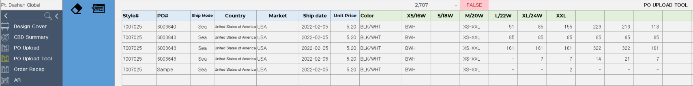
[Legacy System]
Manual update by Order Recap file
Normally the sales team make the Order Recap as follow. And If you look at the size part, you can see that it is written from left to right in a general form. Color part, written from top to bottom.
To update into Server, we must the transformation the data from Order recap to System required form.
Please copy data from Order Recap to “PO Upload tool” with correctly.
Once you finished please click the button as following screen shot. Then system automatically check and calculating whether it update correct or not.

Slide 9
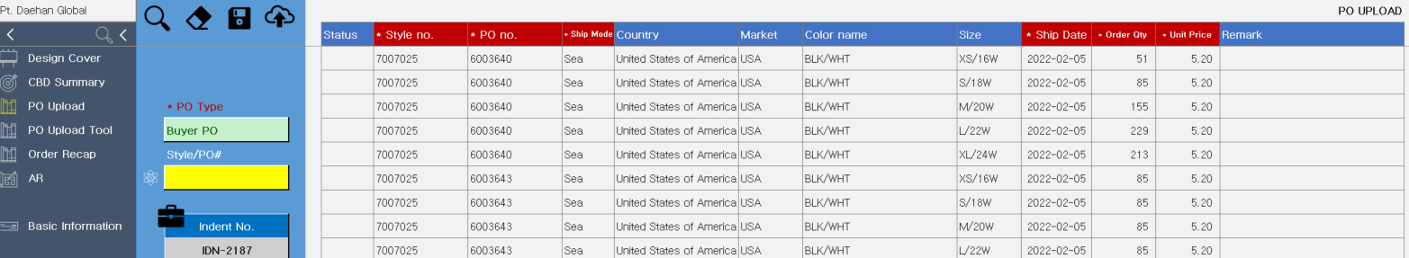
Now you can see and automatically move to sheet name “PO Upload” after check the design no. (or Indent no.) please click the Save button.

Slide 10
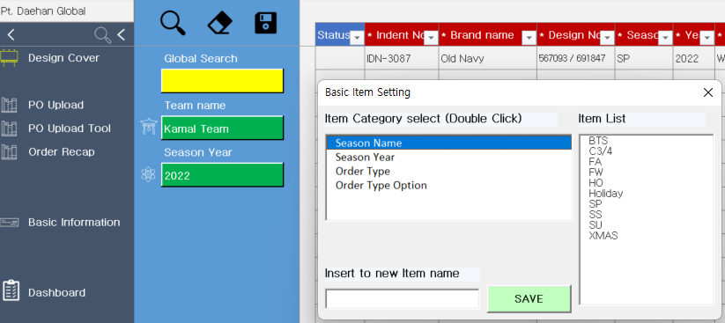
[Legacy System]
How to update the Basic Information update
Click to the button as the screen shot below so window popup will be show.
Please click the item that you needed then you can find out what items was updated into the server. Now New item type in the bottom of inpubox to save.

Slide 11
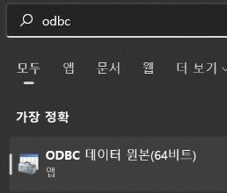
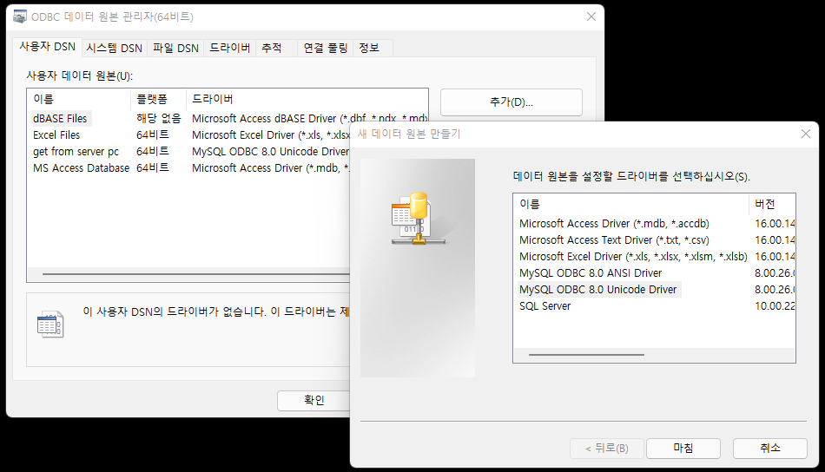
[Legacy System]
How to setup ODBC server
Please prepare the file the list below.
mysql-connector-odbc-8.0.26-win32
mysql-connector-odbc-8.0.26-winx64
VC_redist.x64
Install the file 2 and 3 into your PC. Open to ODBC setup file
Click to “Add” button and choose to “MySQL ODBC 8.0 Unicode Driver

Slide 12
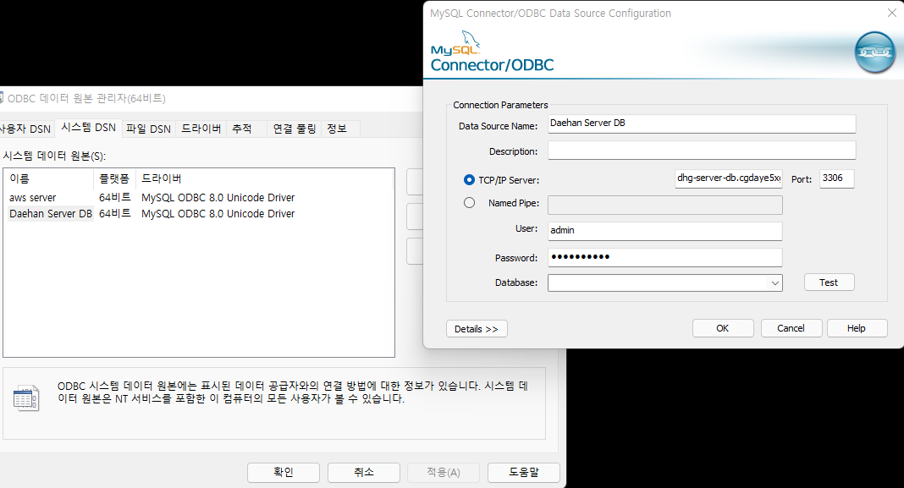
Please update as following
Data Source Name : Daehan Server DB
The Host name : dhg-server-db.cgdaye5xgb9y.ap-northeast-2.rds.amazonaws.com
Port : 3306
User : admin
Password : daehan12!!

